Slide 1
Session 8 LATIN SQUARE & OTHER DESIGNS

Slide 2
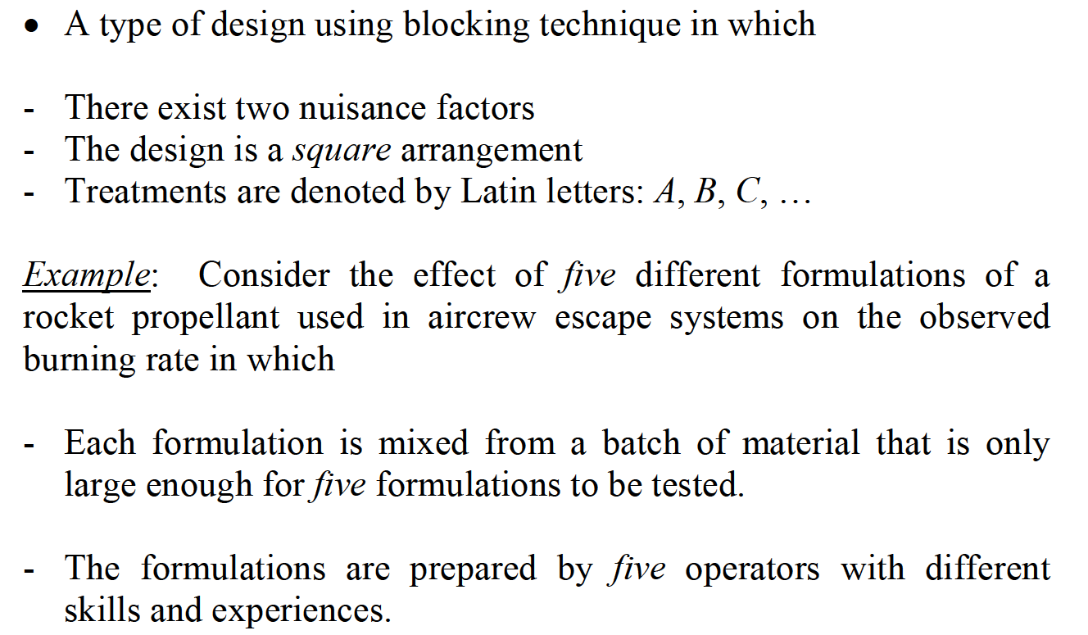
LATIN SQUARE DESIGN

Slide 3
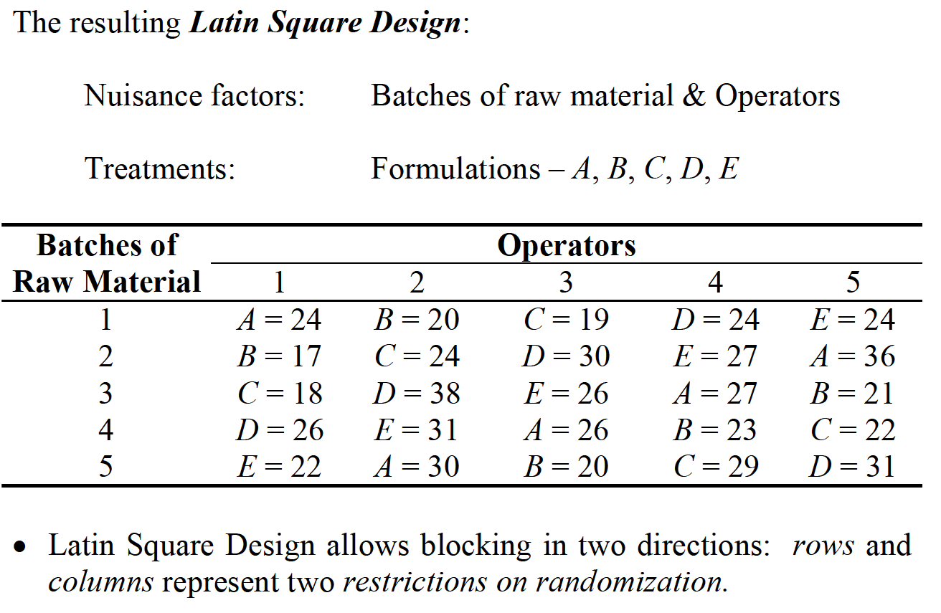
LATIN SQUARE DESIGN

Slide 4
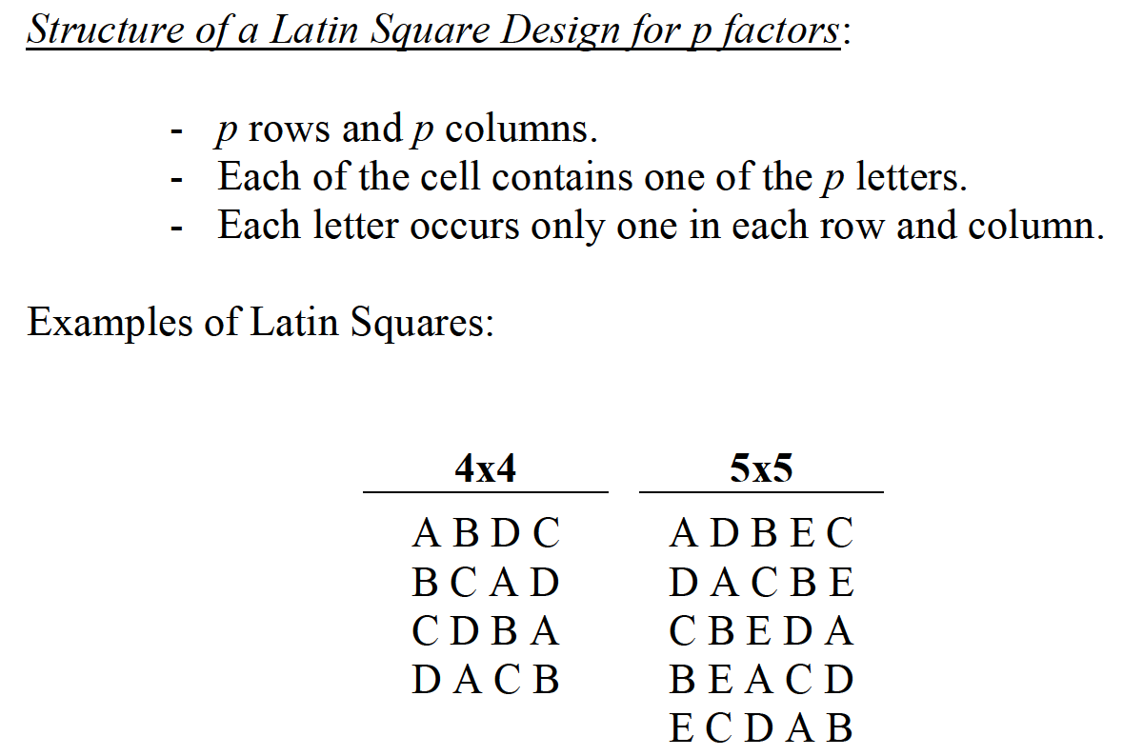
LATIN SQUARE DESIGN

Slide 5
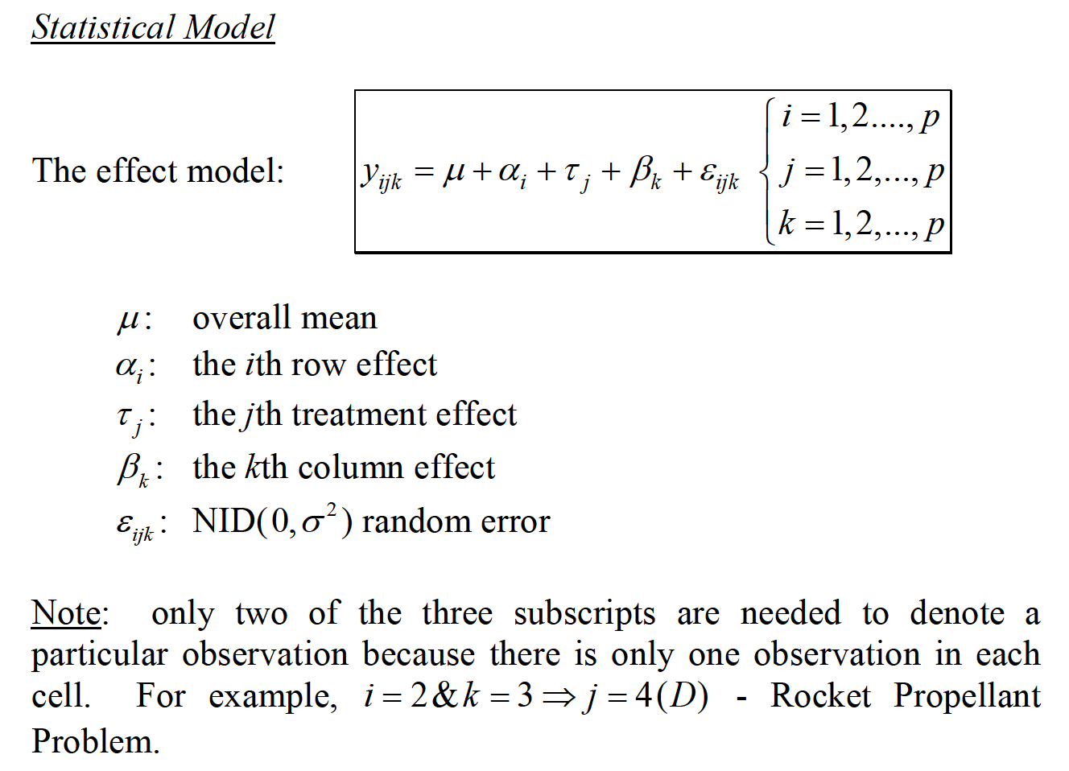
LATIN SQUARE DESIGN

Slide 6
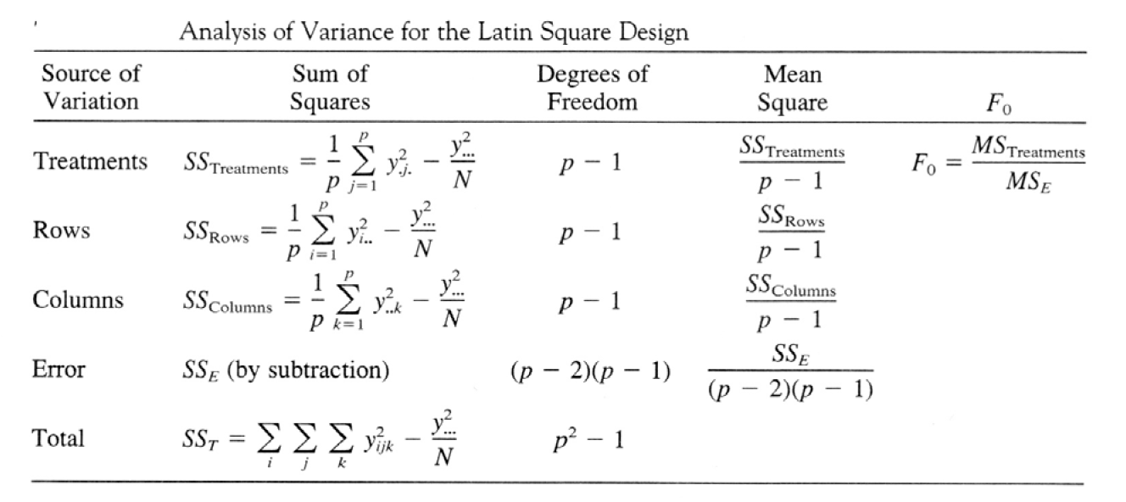
LATIN SQUARE DESIGN

Slide 7
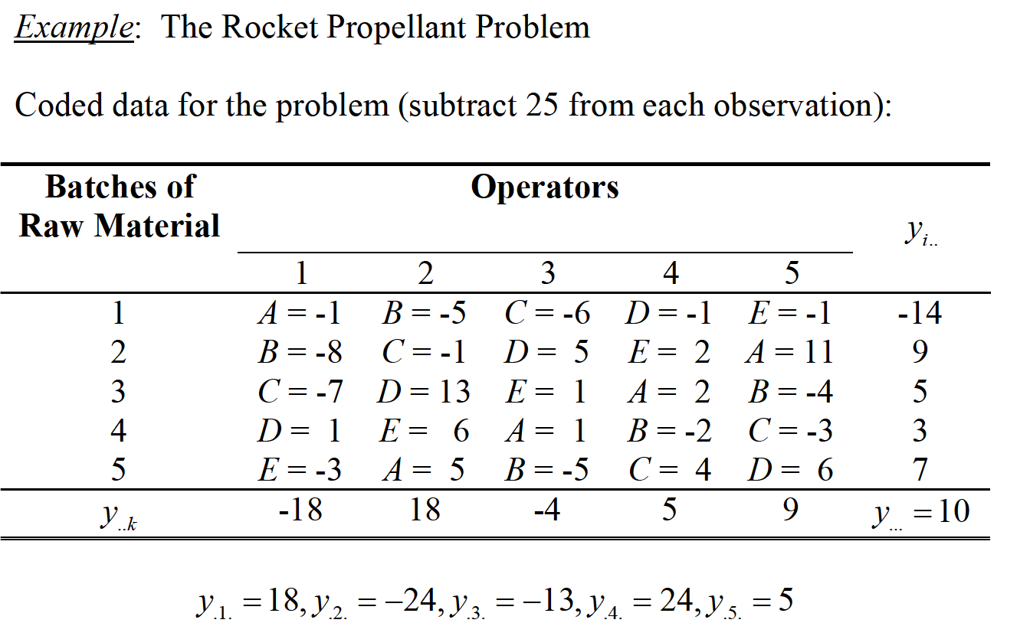
LATIN SQUARE DESIGN

Slide 8
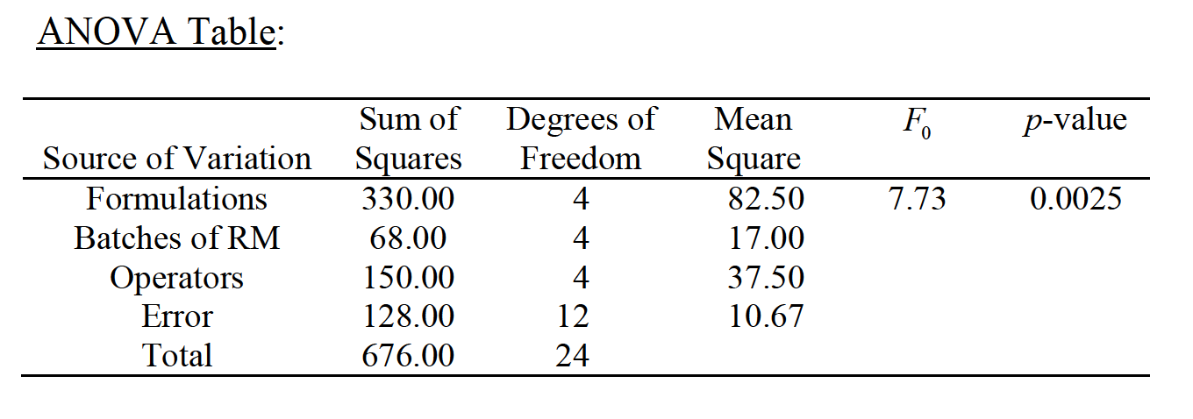
LATIN SQUARE DESIGN

Slide 9
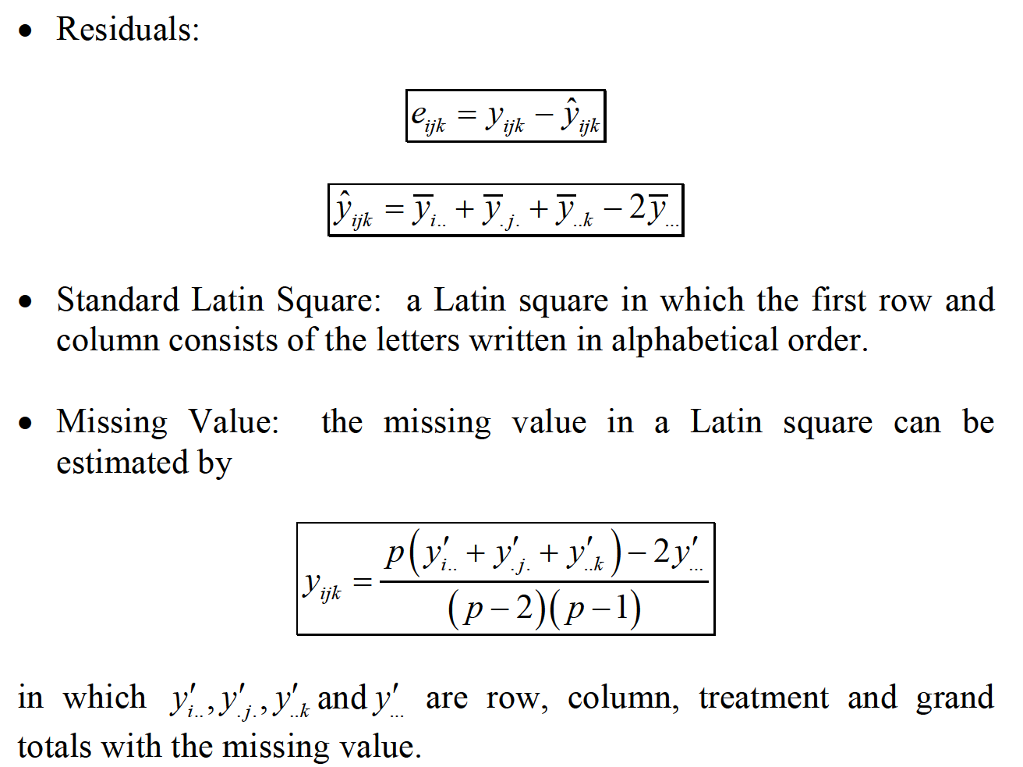
LATIN SQUARE DESIGN

Slide 10
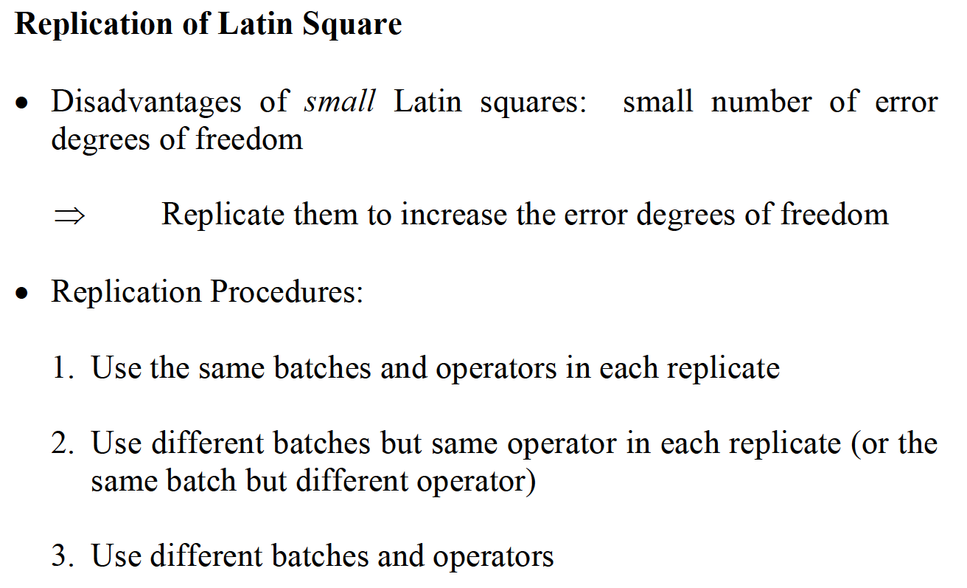
LATIN SQUARE DESIGN

Slide 11
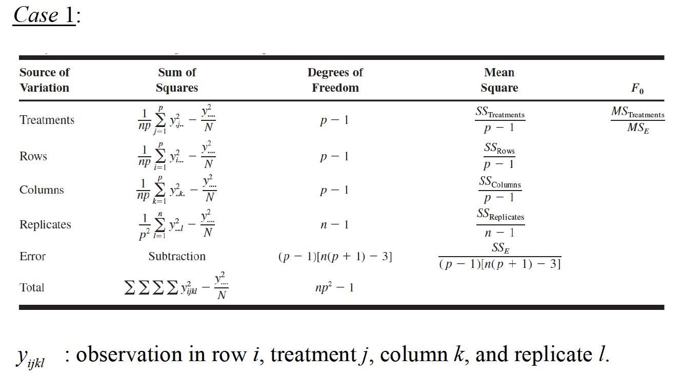
LATIN SQUARE DESIGN

Slide 12
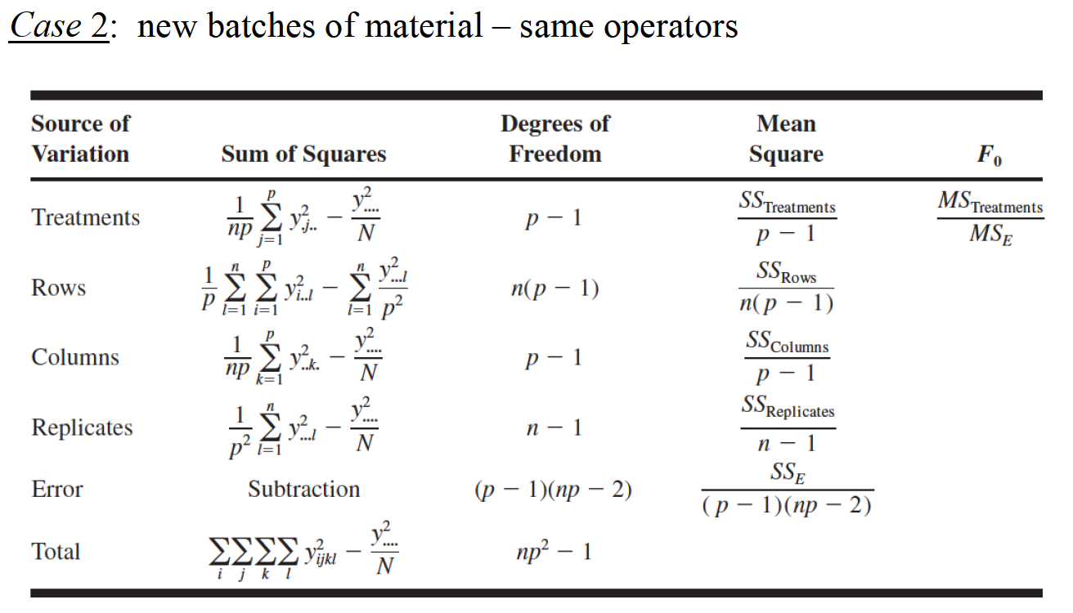
LATIN SQUARE DESIGN

Slide 13
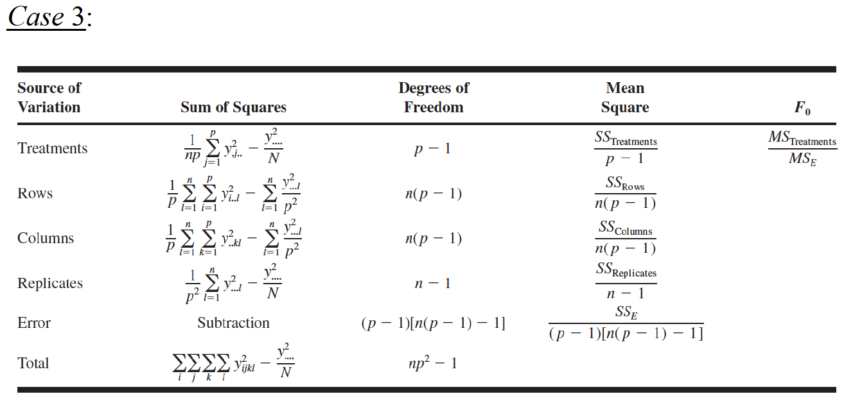
LATIN SQUARE DESIGN

Slide 14
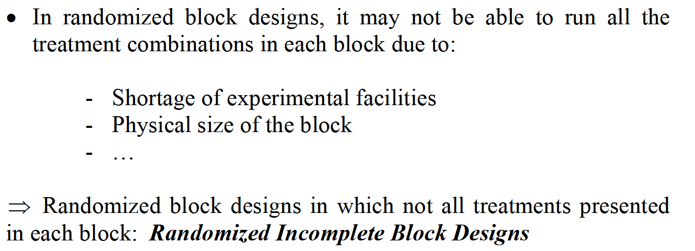
BALANCED INCOMPLETE BLOCK DESIGN

Slide 15
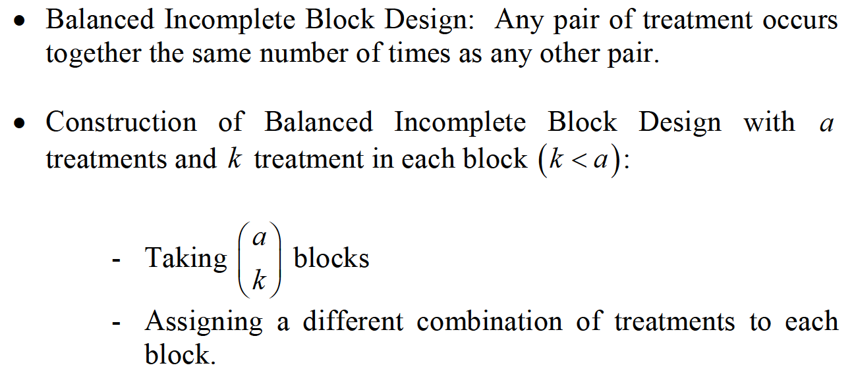
BALANCED INCOMPLETE BLOCK DESIGN

Slide 16
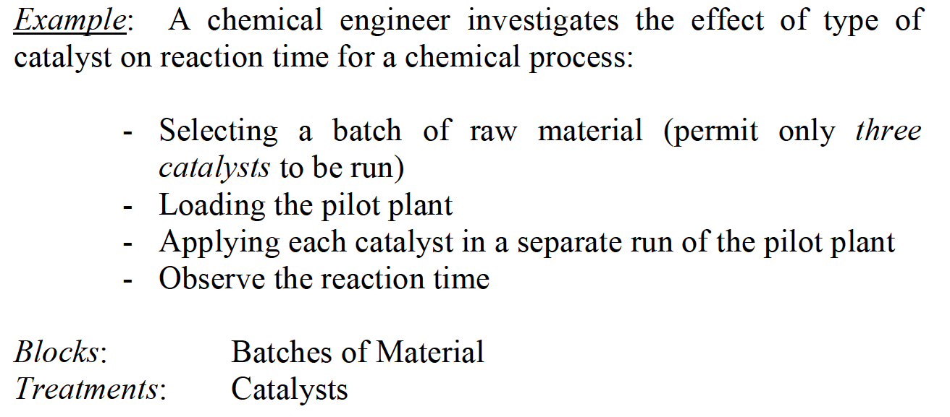
BALANCED INCOMPLETE BLOCK DESIGN

Slide 17
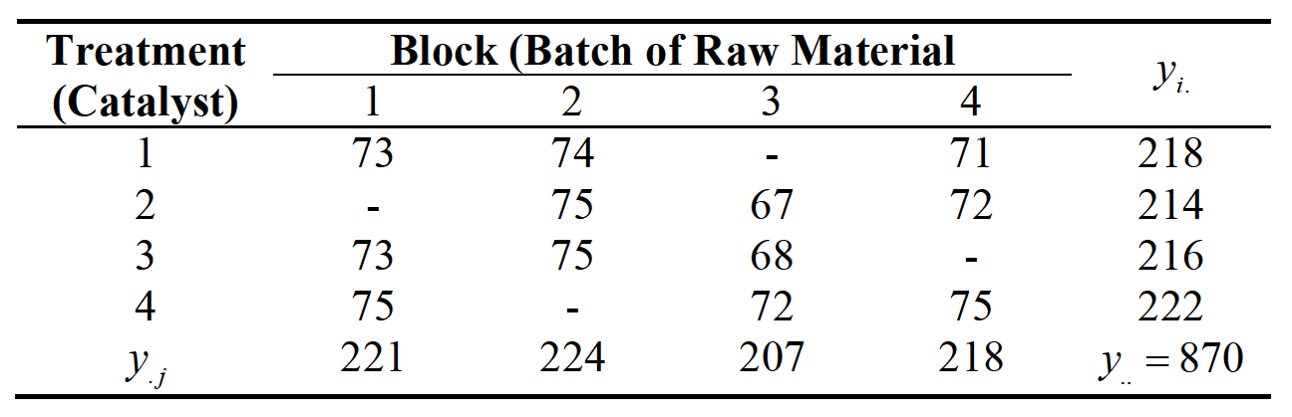
BALANCED INCOMPLETE BLOCK DESIGN

Slide 18
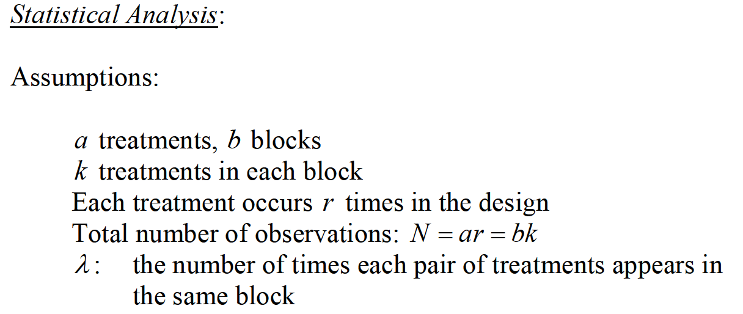
BALANCED INCOMPLETE BLOCK DESIGN

Slide 19
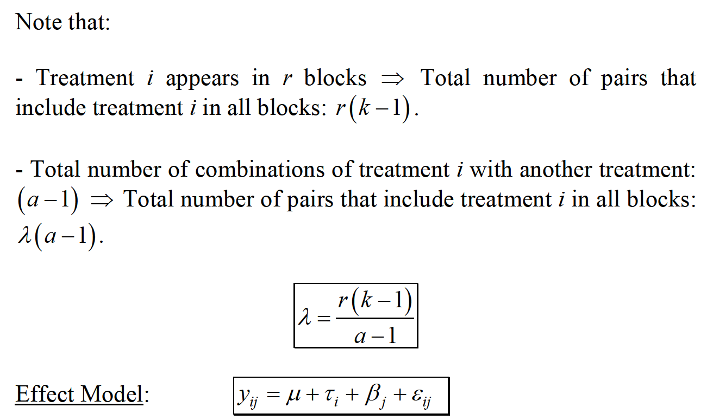
BALANCED INCOMPLETE BLOCK DESIGN

Slide 20
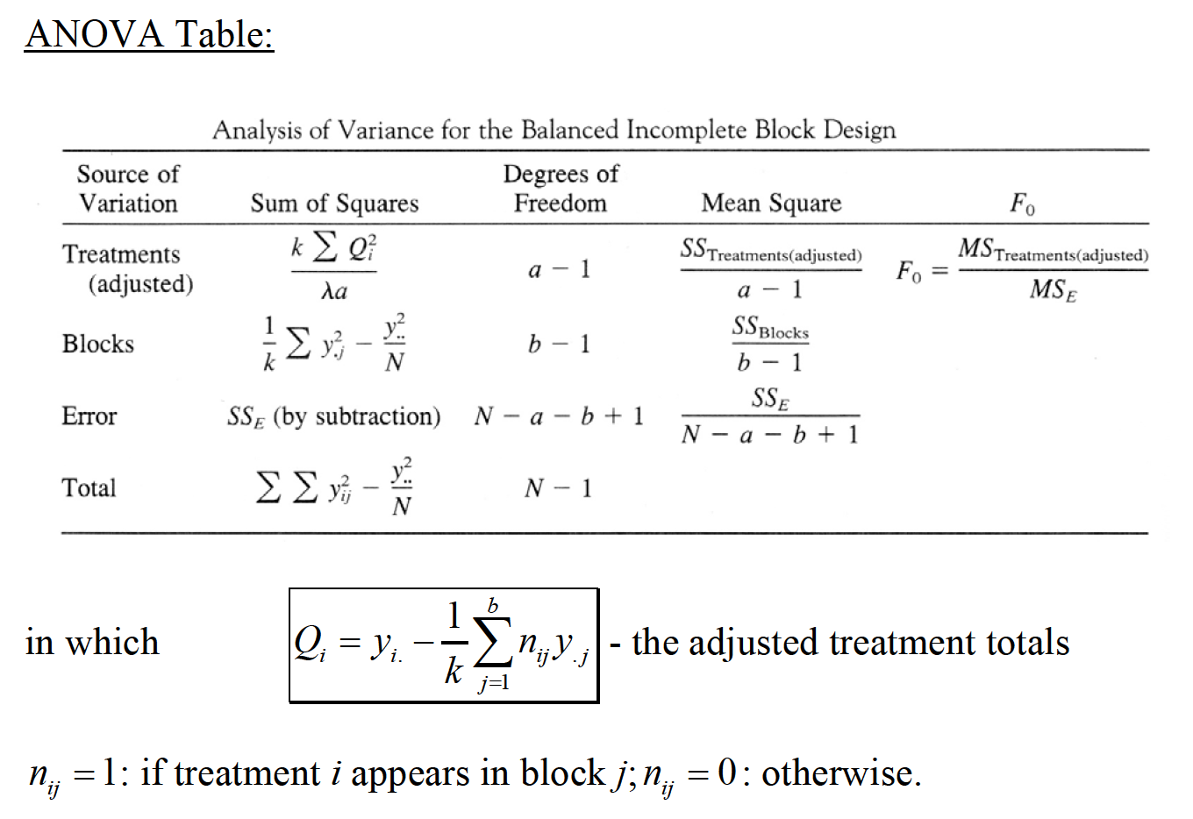
BALANCED INCOMPLETE BLOCK DESIGN

Slide 21
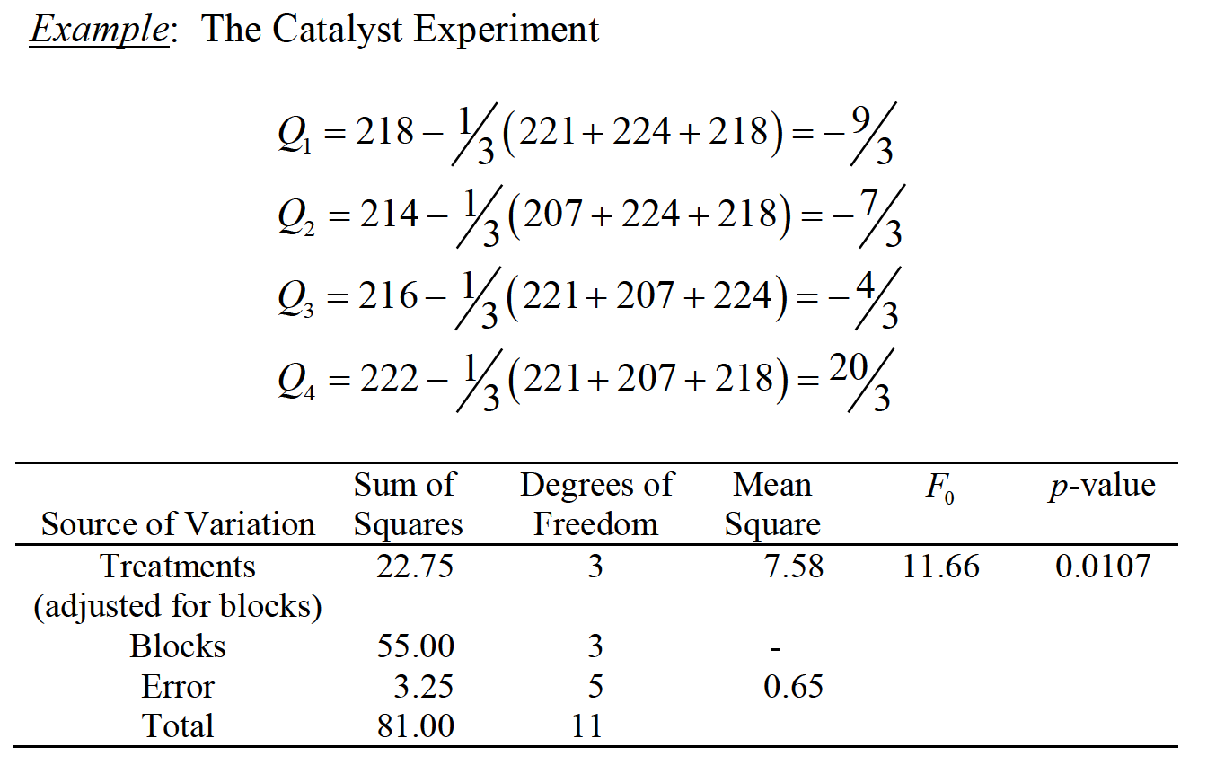
BALANCED INCOMPLETE BLOCK DESIGN

Slide 22
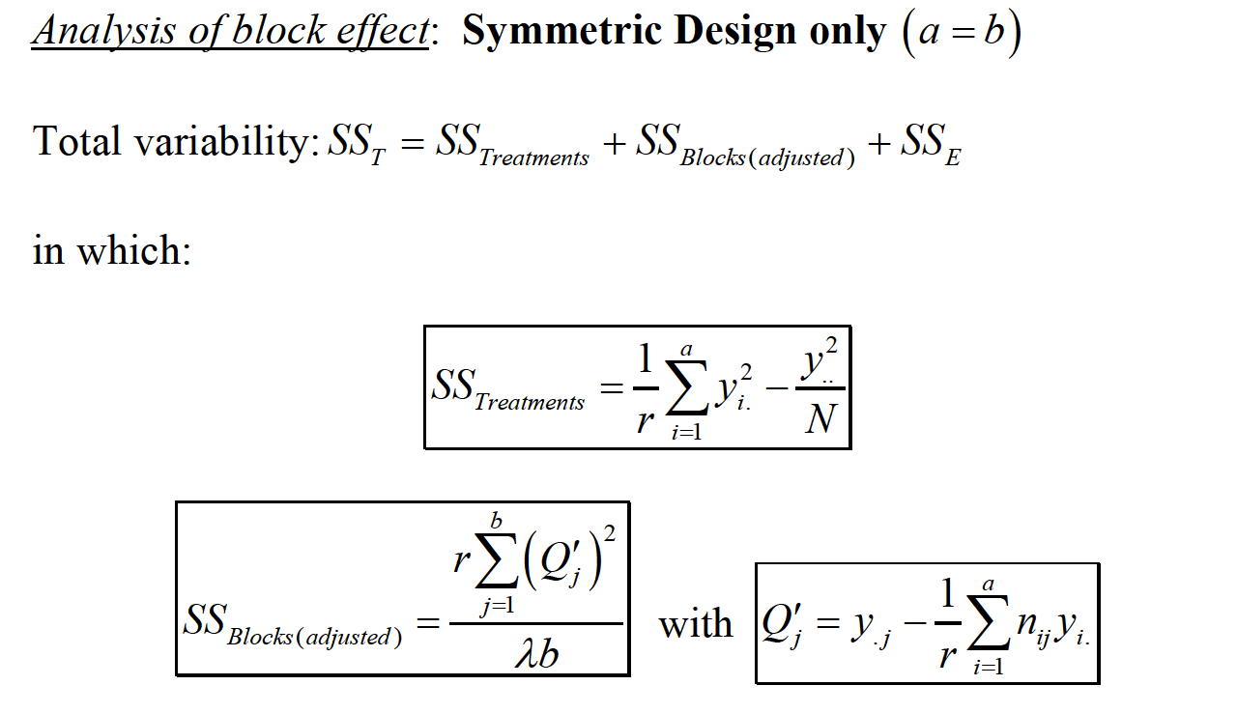
BALANCED INCOMPLETE BLOCK DESIGN

Slide 23
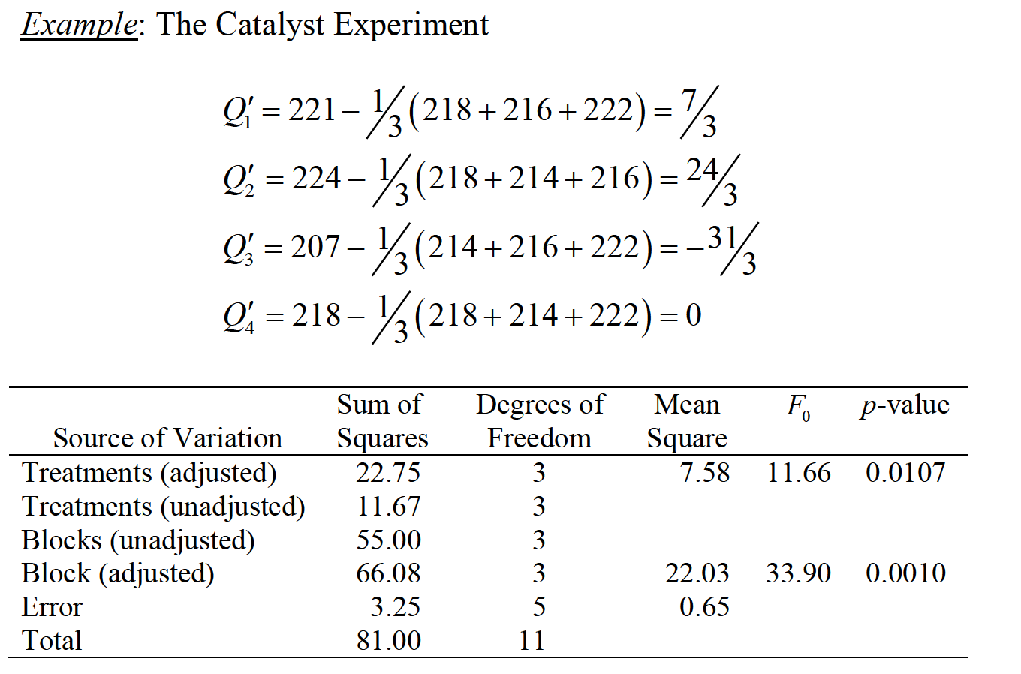
BALANCED INCOMPLETE BLOCK DESIGN

Slide 24
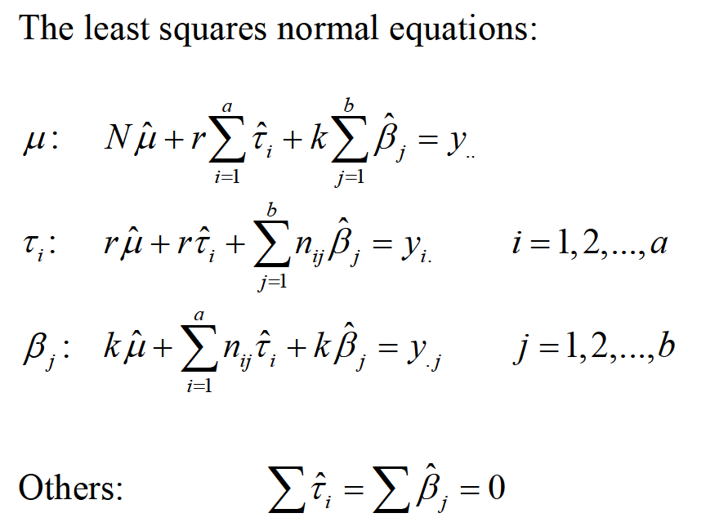
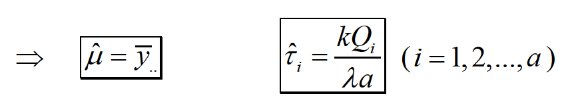
BALANCED INCOMPLETE BLOCK DESIGN

Slide 25
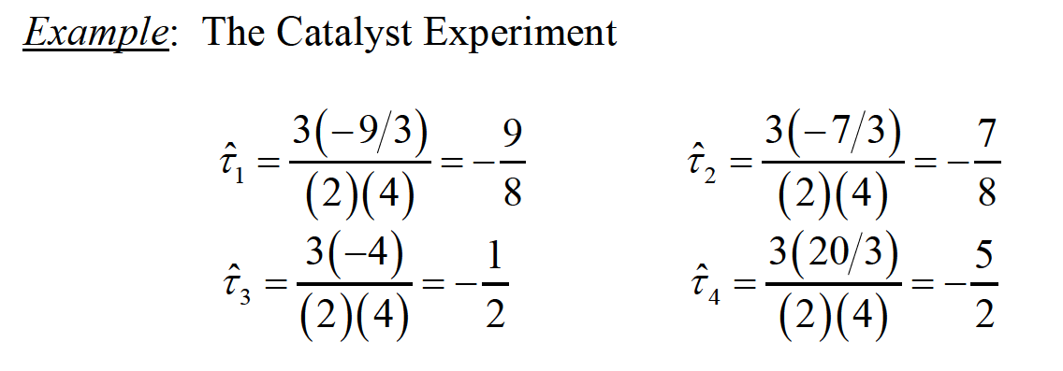
BALANCED INCOMPLETE BLOCK DESIGN

